Slide 1
A Measure for Objective Evaluation of Image Segmentation Algorithms
Dan Yuan
Nov 10, 2005

Slide 2
The Problem
Usually, the performance of segmentation and classification is evaluated using only a single ground truth. What if there are multiple ground truth?
The evaluation results should be comparable across different images (i.e., with a common baseline)
This paper introduces a measure that makes this comparison by quantifying the agreement of an output segmentation with various manual segmentations with a scoring baseline

Slide 3
Diagram
Normalized Probabilistic Rand Index
Adjusted Rand Index
Probabilistic Rand Index
…
GCE/LCE
Rand Index
Cohen’s Kappa
…

Slide 4
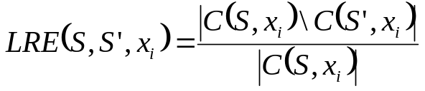
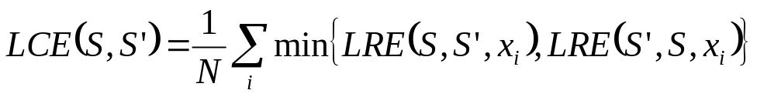
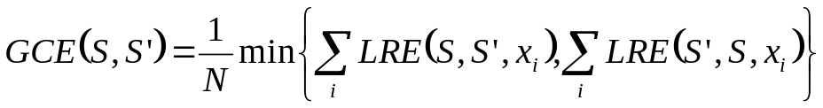
Global Consistency Error and Local Consistency Error
Let S and S’ be two segmentations as before. For a given point (pixel) x_{i} . Consider the classes (segments) that contain x_{i} in S and S’. These sets are denoted by C(S,x_{i}) and C(S’,x_{i}).
Measures the degree to which S and S’ agree
Two ways to combine pixel-wise errors above

Slide 5
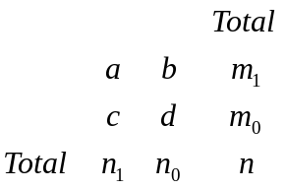



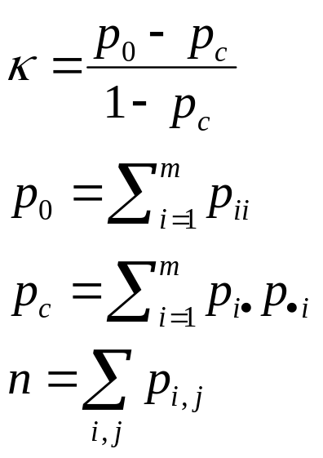

Cohen’s Kappa
Let p_{ij} be the proportion of subjects that were placed in the (i,j) cell
Also define
Cohen’s Kappa is defined
Expected agreement
Agreement
Proportion of agreement
Proportion of agreement expected by chance

Slide 6
Properties of Various Measures of Similarity
 | Cohen’s Kappa | Rand Index | GCE/LCE | Prob. RI
Label Type | Non- permutable | Permutable | Permutable | Permutable
Required Cardinality | equal | any | similar | any
Allows label refinement | no | no | yes | yes
More than 2 segmentatio-ns | no | no | no | yes

Slide 7
Requirements of the Task
Non-degeneracy: Degenerate cases make no exceptions;
No assumptions about data generation: not assume equal cardinality of labels or region sizes in the segmentations;
Adaptive accommodation of refinement
Multiple ground truth
Comparable scores: The comparison must be meaningful.

Slide 8
Category of RI
Rand Index: The base of its derivatives;
Probabilistic Rand (PR) Index: meets first, second , third and fourth requirements;
Normalized Probabilistic Rand (NPR) Index: meets all the requirements;

Slide 9




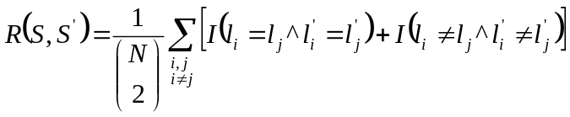
Rand Index
Given two valid label assignments S and S’ of N points that assign labels and respectively to points The Rand Index is defined as follows:
  Note:
  The number of labels in S and S’ are not restricted to be equal;
  RI only deals with a singular ground truth
?
?

Slide 10



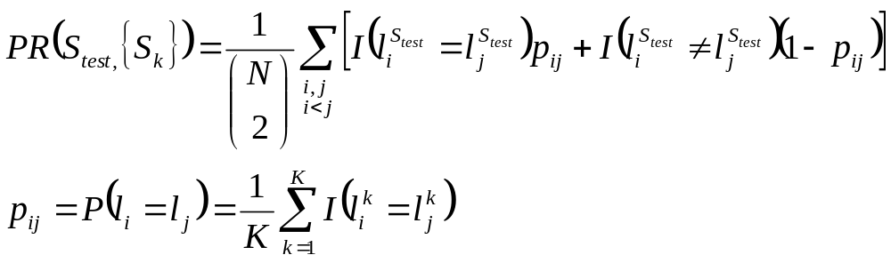
Probabilistic Rand Index
Given multiple ground truth
  corresponding to an image
  is the segmentation of a test image.
  This measure takes the value in [0,1].

Slide 11
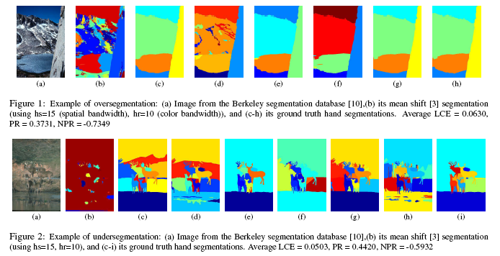
Example

Slide 12
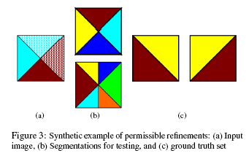
Tolerance of refinement

Slide 13
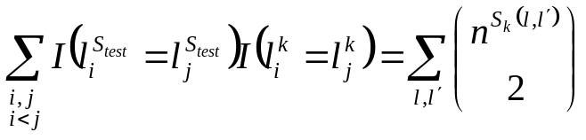
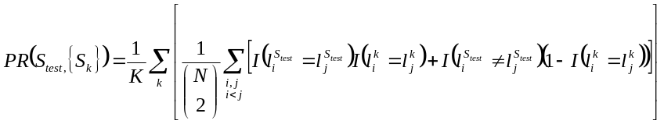


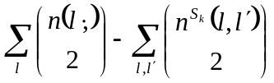
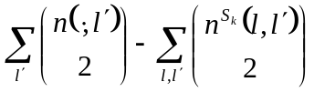
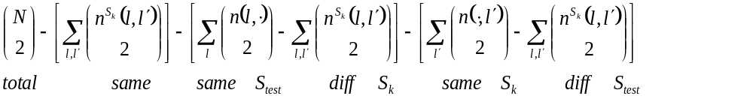
The Presentation by Contingency map
# of pairs having the same label in S_{test} and S_{k}
# of pairs having different labels in S_{test} and S_{k}
Define two terms:
1. # of points having label l in S_{test}
2. # of points having label l’ in S_{k}
The # of pairs of points in the same class in S_{test} different in S_{k}
The # of pairs of points in the same class in S_{k} different in S_{test}

Slide 14

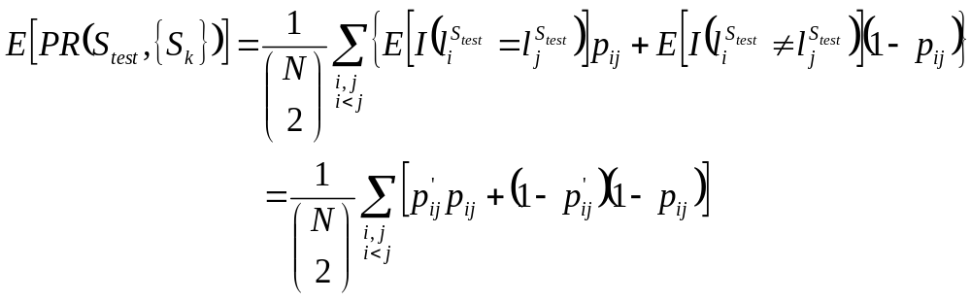
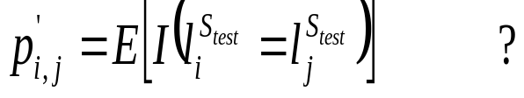
Normalized Probabilistic Rand Index
A popular strategy is to use the index normalized with respect to its baseline as
The expected PR is
What is the meaningful way to compute

Slide 15

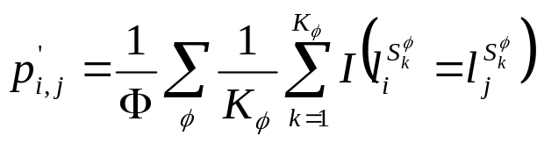



Modeling Expectation
Pair-wise probabilities provide a convenient way to model such segmentations of natural images. We estimate from segmentations of all images for all unordered pair (i,j).
  where is the number of images in a dataset
  is the number of ground truth segmentations of image

Slide 16
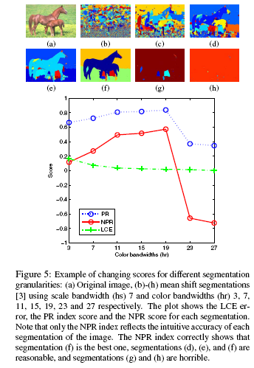
Advantages
The error produced by two segmentations with differing cluster sizes can be compared.

Slide 17
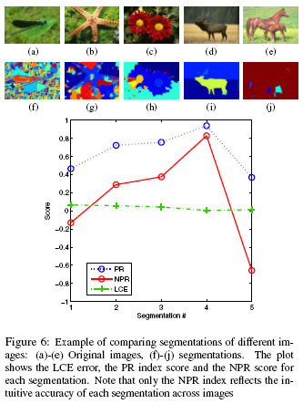
Advantages (cont’d)
It is possible to compare the segmentation errors for different images to their respective ground truth. This facilitates the comparison of an algorithm’s performance on different images.

Slide 18
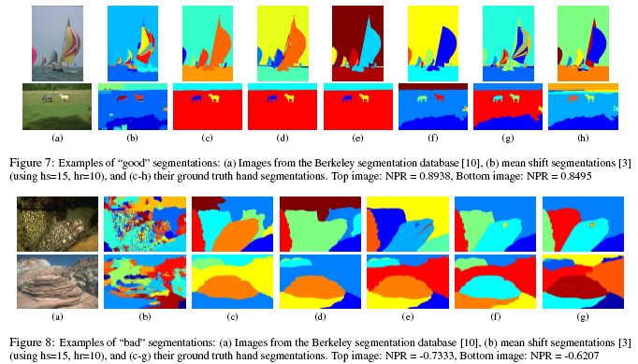
Consistency of NPR
The following figures show the consistency of NPR

Slide 19
Thank you!

